Slide 1
SQL: The Query Language
courtesy of Joe Hellerstein and etc for some slides.

Slide 2
Review
Relational Algebra (Operational Semantics)
  Given a query, how to mix and match the relational algebra operators to answer it
  Used for query optimization
Relational Calculus (Declarative Semantics)
  Given a query, what do I want my answer set to include?
Algebra and safe calculus are simple and powerful models for query languages for relational model
  Have same expressive power
SQL can express every query that is expressible in relational algebra/calculus. (and more)

Slide 3



Relational Query Languages
Rel. Algebra Query 1
Rel. Algebra Query 2
SQL Query
.
.
.
Rel. Algebra Query n
Pick the cheapest one

Slide 4
Relational Query Languages
Two sublanguages:
  DDL – Data Definition Language
    Define and modify schema (at all 3 levels)
  DML – Data Manipulation Language
    Queries can be written intuitively.
DBMS is responsible for efficient evaluation.
  The key: precise semantics for relational queries.
  Optimizer can re-order operations
    Won’t affect query answer.
  Choices driven by “cost model”

Slide 5
The SQL Query Language
The most widely used relational query language.
Standardized
  (although most systems add their own “special sauce” -- including PostgreSQL)
We will study SQL92 -- a basic subset

Slide 6
Example Database
Sailors
Boats
sid | sname | rating | age
1 | Fred | 7 | 22
2 | Jim | 2 | 39
3 | Nancy | 8 | 27
bid | bname | color
101 | Nina | red
102 | Pinta | blue
103 | Santa Maria | red
Reserves
sid | bid | day
1 | 102 | 9/12
2 | 102 | 9/13

Slide 7
The SQL DDL
sid | sname | rating | age
1 | Fred | 7 | 22
2 | Jim | 2 | 39
3 | Nancy | 8 | 27
CREATE TABLE Sailors (
sid INTEGER,
sname CHAR(20),
rating INTEGER,
age REAL,
PRIMARY KEY sid);
CREATE TABLE Boats (
bid INTEGER,
bname CHAR (20),
color CHAR(10)
PRIMARY KEY bid);
CREATE TABLE Reserves (
sid INTEGER,
bid INTEGER,
day DATE,
PRIMARY KEY (sid, bid, day),
FOREIGN KEY sid REFERENCES Sailors,
FOREIGN KEY bid REFERENCES Boats);
bid | bname | color
101 | Nina | red
102 | Pinta | blue
103 | Santa Maria | red
sid | bid | day
1 | 102 | 9/12
2 | 102 | 9/13

Slide 8
The SQL DML
Sailors
sid | sname | rating | age
1 | Fred | 7 | 22
2 | Jim | 2 | 39
3 | Nancy | 8 | 27
Find all 18-year-old sailors:
SELECT *
FROM Sailors S
WHERE S.age=18
To find just names and ratings, replace the first line:
SELECT S.sname, S.rating

Slide 9
Querying Multiple Relations
SELECT S.sname
FROM Sailors S, Reserves R
WHERE S.sid=R.sid AND R.bid=102
Sailors
Reserves
sid | sname | rating | age
1 | Fred | 7 | 22
2 | Jim | 2 | 39
3 | Nancy | 8 | 27
sid | bid | day
1 | 102 | 9/12
2 | 102 | 9/13

Slide 10
Basic SQL Query
DISTINCT: optional. Answer should not contain duplicates.
  SQL default: duplicates are not eliminated! (Result a “multiset”)
target-list : List of expressions over attributes of tables in relation-list
SELECT [DISTINCT] target-list
FROM relation-list
WHERE qualification
qualification : Comparisons combined using AND, OR and NOT. Comparisons are Attr op const or Attr1 op Attr2, where op is one of =,<,>,≠, etc.
relation-list : List of relation names, possibly with a range-variable after each name

Slide 11
Query Semantics
SELECT [DISTINCT] target-list
FROM relation-list
WHERE qualification
  1. FROM : compute cross product of tables.
  2. WHERE : Check conditions, discard tuples that fail.
  3. SELECT : Delete unwanted fields.
  4. DISTINCT (optional) : eliminate duplicate rows.
Note: Probably the least efficient way to compute a query!
  Query optimizer will find more efficient ways to get the same answer.

Slide 12
Find sailors who’ve reserved at least one boat
SELECT
FROM
WHERE
S.sid
Sailors S, Reserves R
S.sid=R.sid
Would DISTINCT make a difference here?
What is the effect of replacing S.sid by S.sname in the SELECT clause?
  Would DISTINCT make a difference to this variant of the query?

Slide 13
About Range Variables
Needed when ambiguity could arise.
  e.g., same table used multiple times in FROM (“self-join”)
SELECT x.sname, x.age, y.sname, y.age
FROM Sailors x, Sailors y
WHERE x.age > y.age
Sailors
sid | sname | rating | age
1 | Fred | 7 | 22
2 | Jim | 2 | 39
3 | Nancy | 8 | 27

Slide 14
Arithmetic Expressions
SELECT S.age, S.age-5 AS age1, 2*S.age AS age2
FROM Sailors S
WHERE S.sname = ‘dustin’
SELECT S1.sname AS name1, S2.sname AS name2
FROM Sailors S1, Sailors S2
WHERE 2*S1.rating = S2.rating - 1

Slide 15
String Comparisons
  `_’ stands for any one character and `%’ stands for 0 or more arbitrary characters.
SELECT S.sname
FROM Sailors S
WHERE S.sname LIKE ‘B_%B’

Slide 16
Find sid’s of sailors who’ve reserved a red or a green boat
SELECT R.sid
FROM Boats B, Reserves R
WHERE R.bid=B.bid AND
(B.color=‘red’ OR
B.color=‘green’)
... or:
SELECT R.sid
FROM Boats B, Reserves R
WHERE R.bid=B.bid AND
B.color=‘red’
UNION
SELECT R.sid
FROM Boats B, Reserves R
WHERE R.bid=B.bid AND B.color=‘green’

Slide 17
Find sid’s of sailors who’ve reserved a red and a green boat
SELECT R.sid
FROM Boats B,Reserves R
WHERE R.bid=B.bid AND
(B.color=‘red’ AND B.color=‘green’)

Slide 18
Find sid’s of sailors who’ve reserved a red and a green boat
SELECT S.sid
FROM Sailors S, Boats B, Reserves R
WHERE S.sid=R.sid
AND R.bid=B.bid
AND B.color=‘red’
INTERSECT
SELECT S.sid
FROM Sailors S, Boats B, Reserves R
WHERE S.sid=R.sid
AND R.bid=B.bid
AND B.color=‘green’

Slide 19
Find sid’s of sailors who’ve reserved a red and a green boat
Could use a self-join:
SELECT R1.sid
FROM Boats B1, Reserves R1,
Boats B2, Reserves R2
WHERE R1.sid=R2.sid
AND R1.bid=B1.bid
AND R2.bid=B2.bid
AND (B1.color=‘red’ AND B2.color=‘green’)

Slide 20
Find sid’s of sailors who have not reserved a boat
SELECT S.sid
FROM Sailors S
EXCEPT
SELECT S.sid
FROM Sailors S, Reserves R
WHERE S.sid=R.sid

Slide 21
Nested Queries: IN
Names of sailors who’ve reserved boat #103:
SELECT S.sname
FROM Sailors S
WHERE S.sid IN
(SELECT R.sid
FROM Reserves R
WHERE R.bid=103)

Slide 22
Nested Queries: NOT IN
Names of sailors who’ve not reserved boat #103:
SELECT S.sname
FROM Sailors S
WHERE S.sid NOT IN
(SELECT R.sid
FROM Reserves R
WHERE R.bid=103)

Slide 23
Nested Queries with Correlation
Names of sailors who’ve reserved boat #103:
SELECT S.sname
FROM Sailors S
WHERE EXISTS
(SELECT *
FROM Reserves R
WHERE R.bid=103 AND S.sid=R.sid)
Subquery must be recomputed for each Sailors tuple.
  Think of subquery as a function call that runs a query

Slide 24
More on Set-Comparison Operators
we’ve seen: IN, EXISTS
can also have: NOT IN, NOT EXISTS
other forms: op ANY, op ALL
Find sailors whose rating is greater than that of some sailor called Horatio:
SELECT *
FROM Sailors S
WHERE S.rating > ANY
(SELECT S2.rating
FROM Sailors S2
WHERE S2.sname=‘Horatio’)

Slide 25
Conceptual SQL Evaluation
SELECT [DISTINCT] target-list
FROM relation-list
WHERE qualification
GROUP BY grouping-list
HAVING group-qualification
Project away columns
(just keep those used in SELECT, GBY, HAVING)
SELECT
[DISTINCT]
Eliminate duplicates
Apply selections
(eliminate rows)
WHERE
HAVING
Eliminate groups
Relation cross-product
FROM
GROUP BY
Form groups & aggregate

Slide 26
Sorting the Results of a Query
ORDER BY column [ ASC | DESC] [, ...]
Can order by any column in SELECT list, including expressions or aggs:
SELECT S.rating, S.sname, S.age
FROM Sailors S, Boats B, Reserves R
WHERE S.sid=R.sid
AND R.bid=B.bid AND B.color=‘red’
ORDER BY S.rating, S.sname;
SELECT S.sid, COUNT (*) AS redrescnt
FROM Sailors S, Boats B, Reserves R
WHERE S.sid=R.sid
AND R.bid=B.bid AND B.color=‘red’
GROUP BY S.sid
ORDER BY redrescnt DESC;

Slide 27
Null Values
Field values are sometimes unknown (e.g., a rating has not been assigned) or inapplicable (e.g., no spouse’s name).
  SQL provides a special value null for such situations.
The presence of null complicates many issues. E.g.:
  Special operators needed to check if value is/is not null.
  Is rating>8 true or false when rating is equal to null? What about AND, OR and NOT connectives?
  We need a 3-valued logic (true, false and unknown).

Slide 28
Joins
SELECT (column_list)
FROM table_name
[INNER | {LEFT |RIGHT | FULL } OUTER] JOIN table_name
ON qualification_list
WHERE …
Explicit join semantics needed unless it is an INNER join
(INNER is default)

Slide 29
Inner Join
Only rows that match the qualification are returned.
SELECT s.sid, s.name, r.bid
FROM Sailors s INNER JOIN Reserves r
ON s.sid = r.sid
Returns only those sailors who have reserved boats.

Slide 30
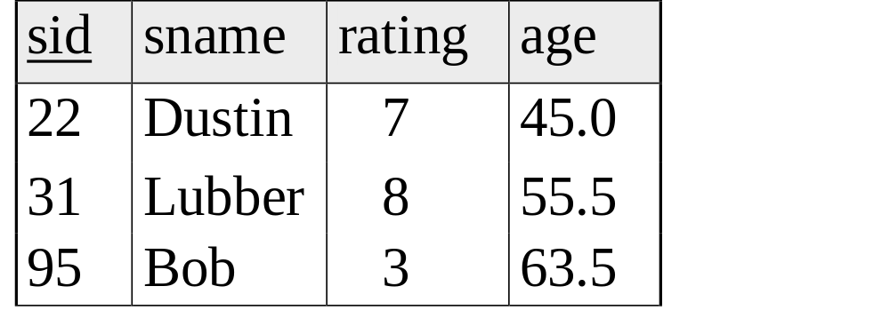
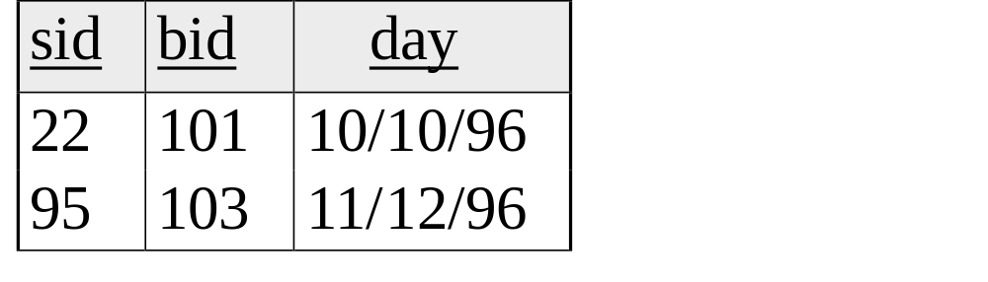
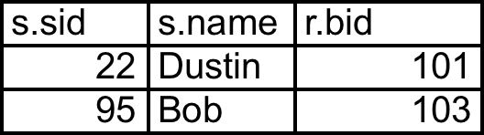
SELECT s.sid, s.name, r.bid
FROM Sailors s INNER JOIN Reserves r
ON s.sid = r.sid

Slide 31
Left Outer Join
Returns all matched rows, plus all unmatched rows from the table on the left of the join clause
(use nulls in fields of non-matching tuples)
SELECT s.sid, s.name, r.bid
FROM Sailors s LEFT OUTER JOIN Reserves r
ON s.sid = r.sid

Slide 32
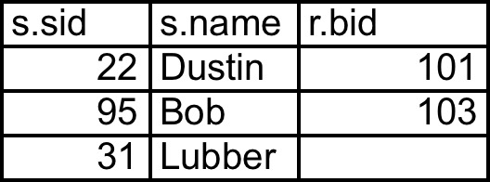
SELECT s.sid, s.name, r.bid
FROM Sailors s LEFT OUTER JOIN Reserves r
ON s.sid = r.sid

Slide 33
Right Outer Join
Right Outer Join returns all matched rows, plus all unmatched rows from the table on the right of the join clause
SELECT r.sid, b.bid, b.name
FROM Reserves r RIGHT OUTER JOIN Boats b
ON r.bid = b.bid

Slide 34
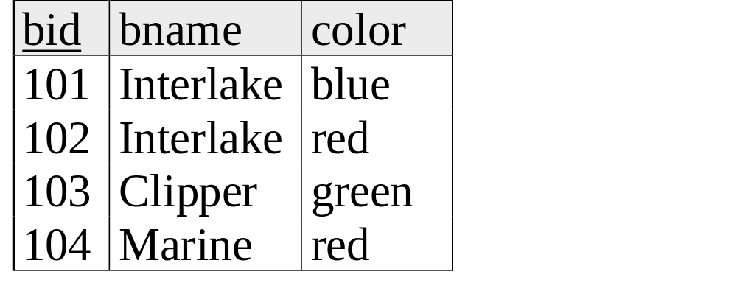
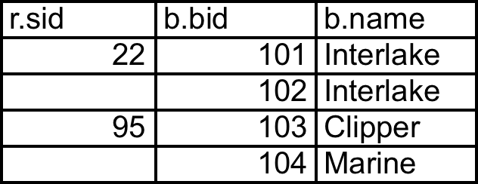
SELECT r.sid, b.bid, b.name
FROM Reserves r RIGHT OUTER JOIN Boats b
ON r.bid = b.bid

Slide 35
Full Outer Join
Full Outer Join returns all (matched or unmatched) rows from the tables on both sides of the join clause
SELECT r.sid, b.bid, b.name
FROM Reserves r FULL OUTER JOIN Boats b
ON r.bid = b.bid

Slide 36
SELECT r.sid, b.bid, b.name
FROM Reserves r FULL OUTER JOIN Boats b
ON r.bid = b.bid
Note: in this case it is the same as the ROJ!
bid is a foreign key in reserves, so all reservations must
have a corresponding tuple in boats.

Slide 37
Aggregate Operators
COUNT (*)
COUNT ( [DISTINCT] A)
SUM ( [DISTINCT] A)
AVG ( [DISTINCT] A)
MAX (A)
MIN (A)
Significant extension of relational algebra.
SELECT COUNT (*)
FROM Sailors S
single column
SELECT AVG (S.age)
FROM Sailors S
WHERE S.rating=10
SELECT COUNT (DISTINCT S.rating)
FROM Sailors S
WHERE S.sname=‘Bob’

Slide 38
Find name and age of the oldest sailor(s)
SELECT S.sname, MAX (S.age)
FROM Sailors S
The first query is incorrect!
Third query equivalent to second query
  allowed in SQL/92 standard, but not supported in some systems.
SELECT S.sname, S.age
FROM Sailors S
WHERE S.age =
(SELECT MAX (S2.age)
FROM Sailors S2)
SELECT S.sname, S.age
FROM Sailors S
WHERE (SELECT MAX (S2.age)
FROM Sailors S2)
= S.age

Slide 39
GROUP BY and HAVING
So far, we’ve applied aggregate operators to all (qualifying) tuples.
  Sometimes, we want to apply them to each of several groups of tuples.
Consider: Find the age of the youngest sailor for each rating level.
  In general, we don’t know how many rating levels exist, and what the rating values for these levels are!
  Suppose we know that rating values go from 1 to 10; we can write 10 queries that look like this (!):
SELECT MIN (S.age)
FROM Sailors S
WHERE S.rating = i
For i = 1, 2, ... , 10:

Slide 40
Queries With GROUP BY
To generate values for a column based on groups of rows, use aggregate functions in SELECT statements with the GROUP BY clause
SELECT [DISTINCT] target-list
FROM relation-list
[WHERE qualification]
GROUP BY grouping-list
The target-list contains
(i) list of column names &
(ii) terms with aggregate operations (e.g., MIN (S.age)).
  column name list (i) can contain only attributes from the grouping-list.

Slide 41
Group By Examples
For each rating, find the average age of the sailors
SELECT S.rating, AVG (S.age)
FROM Sailors S
GROUP BY S.rating
For each rating find the age of the youngest
sailor with age ≥ 18
SELECT S.rating, MIN (S.age)
FROM Sailors S
WHERE S.age >= 18
GROUP BY S.rating

Slide 42
Conceptual Evaluation
The cross-product of relation-list is computed, tuples that fail qualification are discarded, `unnecessary’ fields are deleted, and the remaining tuples are partitioned into groups by the value of attributes in grouping-list.
One answer tuple is generated per qualifying group.

Slide 43
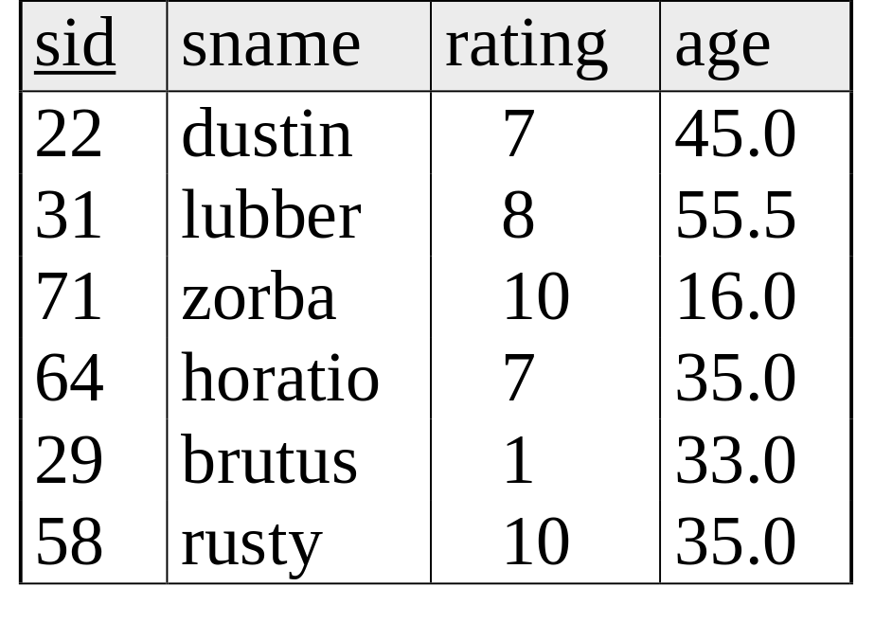
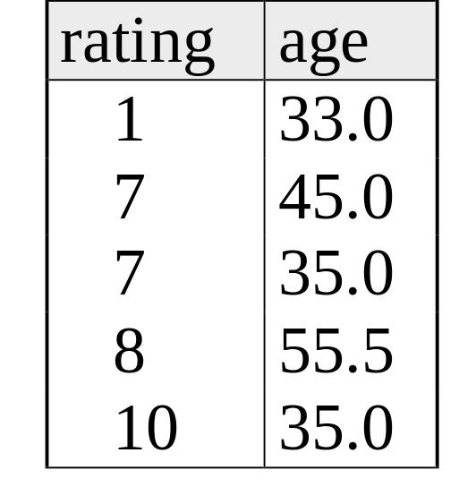
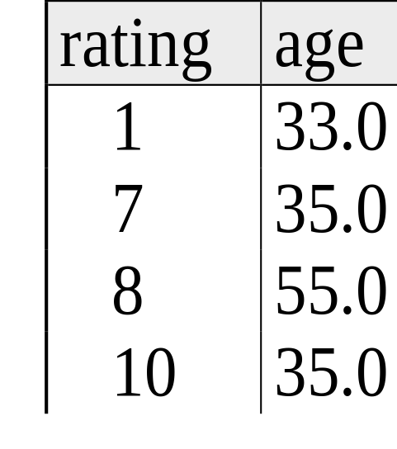
SELECT S.rating, MIN (S.age)
FROM Sailors S
WHERE S.age >= 18
GROUP BY S.rating
3. Perform Aggregation
1. Form cross product
2. Delete unneeded columns, rows; form groups

Slide 44
Find the number of reservations for each red boat.
Grouping over a join of two relations.
SELECT B.bid, COUNT(*)AS scount
FROM Boats B, Reserves R
WHERE R.bid=B.bid
AND B.color=‘red’
GROUP BY B.bid

Slide 45
Queries With GROUP BY and HAVING
SELECT [DISTINCT] target-list
FROM relation-list
WHERE qualification
GROUP BY grouping-list
HAVING group-qualification
Use the HAVING clause with the GROUP BY clause to restrict which group-rows are returned in the result set

Slide 46
Conceptual Evaluation
Form groups as before.
The group-qualification is then applied to eliminate some groups.
  Expressions in group-qualification must have a single value per group!
  That is, attributes in group-qualification must be arguments of an aggregate op or must also appear in the grouping-list. (SQL does not exploit primary key semantics here!)
One answer tuple is generated per qualifying group.

Slide 47
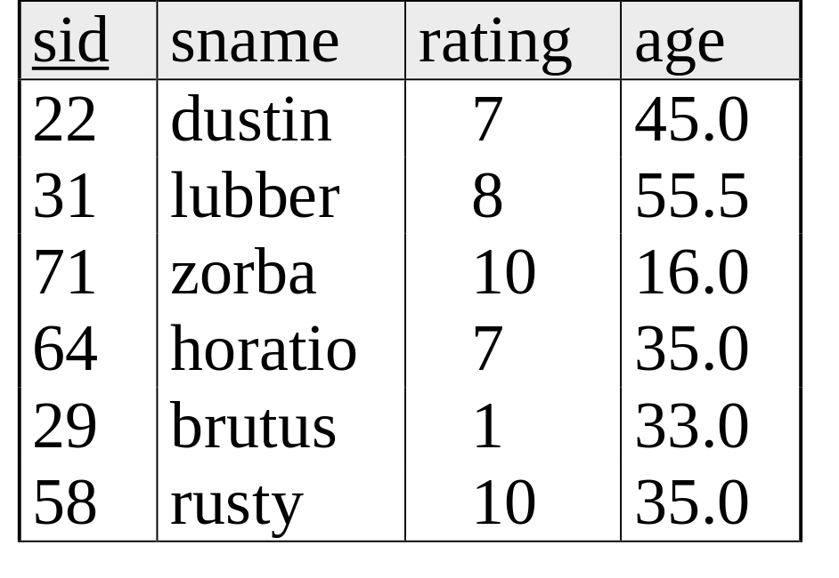
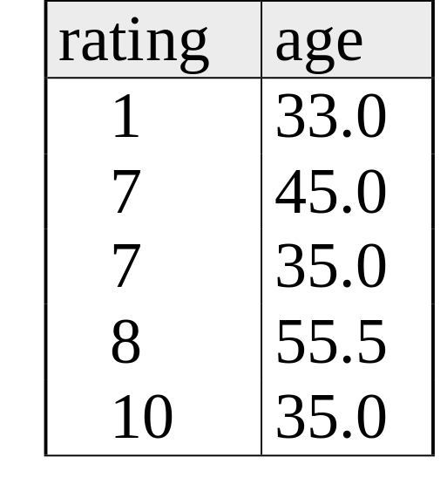
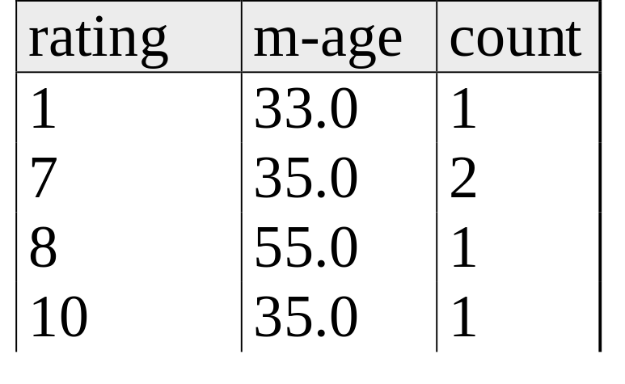
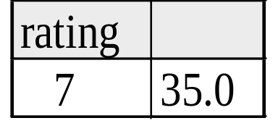
Find the age of the youngest sailor with age ≥ 18, for each rating with at least 2 such sailors
SELECT S.rating, MIN (S.age)
FROM Sailors S
WHERE S.age >= 18
GROUP BY S.rating
HAVING COUNT (*) > 1
Answer

Slide 48
Views: Defining External DB Schemas
CREATE VIEW view_name
AS select_statement
Makes development simpler
Often used for security
Not “materialized”
CREATE VIEW Reds
AS SELECT B.bid, COUNT (*) AS scount
FROM Boats B, Reserves R
WHERE R.bid=B.bid AND B.color=‘red’
GROUP BY B.bid

Slide 49
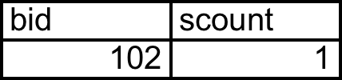
Views Instead of Relations in Queries
CREATE VIEW Reds
AS SELECT B.bid, COUNT (*) AS scount
FROM Boats B, Reserves R
WHERE R.bid=B.bid AND B.color=‘red’
GROUP BY B.bid
Reds
SELECT bname, scount
FROM Reds R, Boats B
WHERE R.bid=B.bid
AND scount < 10

Slide 50
Discretionary Access Control
GRANT privileges ON object TO users [WITH GRANT OPTION]
Object can be a Table or a View
Privileges can be:
  Select
  Insert
  Delete
  References (cols) – allow to create a foreign key that references the specified column(s)
  All
Can later be REVOKEd
Users can be single users or groups
See Chapter 17 for more details.

Slide 51
Two more important topics
Constraints
SQL embedded in other languages

Slide 52
Integrity Constraints (Review)
An IC describes conditions that every legal instance of a relation must satisfy.
  Inserts/deletes/updates that violate IC’s are disallowed.
  Can ensure application semantics (e.g., sid is a key), or prevent inconsistencies (e.g., sname has to be a string, age must be < 200)
Types of IC’s: Domain constraints, primary key constraints, foreign key constraints, general constraints.
Notes:
5

Slide 53
General Constraints
CREATE TABLE Sailors
( sid INTEGER,
sname CHAR(10),
rating INTEGER,
age REAL,
PRIMARY KEY (sid),
CHECK ( rating >= 1
AND rating <= 10 ))
Useful when more general ICs than keys are involved.
Can use queries to express constraint.
Checked on insert or update.
Constraints can be named.
CREATE TABLE Reserves
( sname CHAR(10),
bid INTEGER,
day DATE,
PRIMARY KEY (bid,day),
CONSTRAINT noInterlakeRes
CHECK (`Interlake’ <>
( SELECT B.bname
FROM Boats B
WHERE B.bid=bid)))
Notes:
8

Slide 54
Summary
Relational model has well-defined query semantics
SQL provides functionality close to basic relational model
  (some differences in duplicate handling, null values, set operators, …)
Typically, many ways to write a query
  DBMS figures out a fast way to execute a query, regardless of how it is written.

